Slide 1
Outline
Introduction
Background
Distributed Database Design
Database Integration
Semantic Data Control
Distributed Query Processing
Overview
Query decomposition and localization
Distributed query optimization
Multidatabase Query Processing
Distributed Transaction Management
Data Replication
Parallel Database Systems
Distributed Object DBMS
Peer-to-Peer Data Management
Web Data Management
Current Issues

Slide 2
Step 3 – Global Query Optimization
Input: Fragment query
Find the best (not necessarily optimal) global schedule
Minimize a cost function
Distributed join processing
Bushy vs. linear trees
Which relation to ship where?
Ship-whole vs ship-as-needed
Decide on the use of semijoins
Semijoin saves on communication at the expense of more local processing.
Join methods
nested loop vs ordered joins (merge join or hash join)

Slide 3
Cost-Based Optimization
Solution space
The set of equivalent algebra expressions (query trees).
Cost function (in terms of time)
I/O cost + CPU cost + communication cost
These might have different weights in different distributed environments (LAN vs WAN).
Can also maximize throughput
Search algorithm
How do we move inside the solution space?
Exhaustive search, heuristic algorithms (iterative improvement, simulated annealing, genetic,…)

Slide 4
Query Optimization Process
Input Query
Search Space
Generation
Transformation
Rules
Equivalent QEP
Search
Strategy
Cost Model
Best QEP

Slide 5
Search Space
▷◁ _{PNO}
Search space characterized by alternative execution
Focus on join trees
For N relations, there are O(N!) equivalent join trees that can be obtained by applying commutativity and associativity rules
SELECT ENAME,RESP
FROM EMP, ASG,PROJ
WHERE EMP.ENO=ASG.ENO
AND ASG.PNO=PROJ.PNO
▷◁ _{ENO}
PROJ
EMP
ASG
▷◁ _{ENO}
▷◁ _{PNO}
EMP
PROJ
ASG
▷◁ _{ENO,PNO}
×
ASG
PROJ
EMP

Slide 6
Search Space
Restrict by means of heuristics
Perform unary operations before binary operations
…
Restrict the shape of the join tree
Consider only linear trees, ignore bushy ones
Linear Join Tree
Bushy Join Tree
⋈
⋈
⋈
R₄
⋈
R₃
⋈
⋈
R₁
R₂
R₁
R₂
R₃
R₄

Slide 7
Search Strategy
How to “move” in the search space.
Deterministic
Start from base relations and build plans by adding one relation at each step
Dynamic programming: breadth-first
Greedy: depth-first
Randomized
Search for optimalities around a particular starting point
Trade optimization time for execution time
Better when > 10 relations
Simulated annealing
Iterative improvement

Slide 8
Search Strategies
⋈
Deterministic
⋈
⋈
R₄
⋈
⋈
R₃
⋈
R₃
R₁
R₂
R₁
R₂
R₁
R₂
Randomized
⋈
⋈
⋈
R₃
⋈
R₂
R₁
R₂
R₁
R₃

Slide 9
Cost Functions
Total Time (or Total Cost)
Reduce each cost (in terms of time) component individually
Do as little of each cost component as possible
Optimizes the utilization of the resources
Increases system throughput
Response Time
Do as many things as possible in parallel
May increase total time because of increased total activity

Slide 10
Total Cost
Summation of all cost factors
Total cost = CPU cost + I/O cost + communication cost
CPU cost = unit instruction cost ∗ no.of instructions
I/O cost = unit disk I/O cost ∗ no. of disk I/Os
communication cost = message initiation + transmission

Slide 11
Total Cost Factors
Wide area network
Message initiation and transmission costs high
Local processing cost is low (fast mainframes or minicomputers)
Ratio of communication to I/O costs = 20:1
Local area networks
Communication and local processing costs are more or less equal
Ratio = 1:1.6

Slide 12
Response Time
Elapsed time between the initiation and the completion of a query
Response time = CPU time + I/O time + communication time
CPU time = unit instruction time * no. of sequential instructions
I/O time = unit I/O time * no. of sequential I/Os
communication time = unit msg initiation time * no. of sequential msg
+ unit transmission time * no. of sequential bytes

Slide 13
Example
Site 1
x units
Site 3
Site 2
y units
Assume that only the communication cost is considered
Total time = 2 ⋅ message initialization time + unit transmission time * (x+y)
Response time = max {time to send x from 1 to 3, time to send y from 2 to 3}
time to send x from 1 to 3 = message initialization time
+ unit transmission time * x
time to send y from 2 to 3 = message initialization time
+ unit transmission time * y

Slide 14
Optimization Statistics
Primary cost factor: size of intermediate relations
Need to estimate their sizes
Make them precise ⇒ more costly to maintain
Simplifying assumption: uniform distribution of attribute values in a relation

Slide 15
Statistics
For each relation R[A₁, A₂, …, A_{n}] fragmented as R₁, …, R_{r}
length of each attribute: length(A_{i})
the number of distinct values for each attribute in each fragment: card(Π_{Ai}R_{j})
maximum and minimum values in the domain of each attribute: min(A_{i}), max(A_{i})
the cardinalities of each domain: card(dom[A_{i}])
The cardinalities of each fragment: card(R_{j}) Selectivity factor of each operation for relations
For joins
card(R ⋈S)
SF ⋈ (R,S) =
card(R) ∗ card(S)

Slide 16
Intermediate Relation Sizes
Selection
size(R) = card(R) ⋅ length(R)
card(σ_{F}(R)) = SF_{σ}(F) ⋅ card(R)
where
1
S F_{σ}(A = value) =
card(∏_{A}(R))
max(A) – value
S F_{σ}(A >value) =
max(A) – min(A)
value – max(A)
S F_{σ}(A <value) =
max(A) – min(A)
SF_{σ}(p(A_{i})∧ p(A_{j})) = SF_{σ}(p(A_{i})) ⋅ SF_{σ}(p(A_{j}))
SF_{σ}(p(A_{i}) ∨ p(A_{j})) = SF_{σ}(p(A_{i})) + SF_{σ}(p(A_{j})) – (SF_{σ}(p(A_{i})) ⋅ SF_{σ}(p(A_{j})))
SF_{σ}(A∈{value}) = SF_{σ}(A= value) * card({values})

Slide 17
Intermediate Relation Sizes
Projection
card(Π_{A}(R))=card(R)
Cartesian Product
card(R ⋅ S) = card(R) * card(S)
Union
upper bound: card(R ∪ S) = card(R) + card(S)
lower bound: card(R ∪ S) = max{card(R), card(S)}
Set Difference
upper bound: card(R–S) = card(R)
lower bound: 0

Slide 18
Intermediate Relation Size
Join
Special case: A is a key of R and B is a foreign key of S
card(R ⋈_{A=B} S) = card(S)
More general:
card(R ⋈ S) = SF⋈ * card(R) ⋅ card(S)
Semijoin
card(R ⋉_{A} S) = SF⋉(S.A) * card(R)
where
SF⋉(R ⋉_{A} S)= SF⋉(S.A) =
card(∏_{A}(S))
card(dom[A])

Slide 19
Histograms for Selectivity Estimation
For skewed data, the uniform distribution assumption of attribute values yields inaccurate estimations
Use an histogram for each skewed attribute A
Histogram = set of buckets
Each bucket describes a range of values of A, with its average frequency f (number of tuples with A in that range) and number of distinct values d
Buckets can be adjusted to different ranges
Examples
Equality predicate
With (value in Range_{i}), we have: SF_{σ}(A = value) = 1/d_{i}
Range predicate
Requires identifying relevant buckets and summing up their frequencies

Slide 20
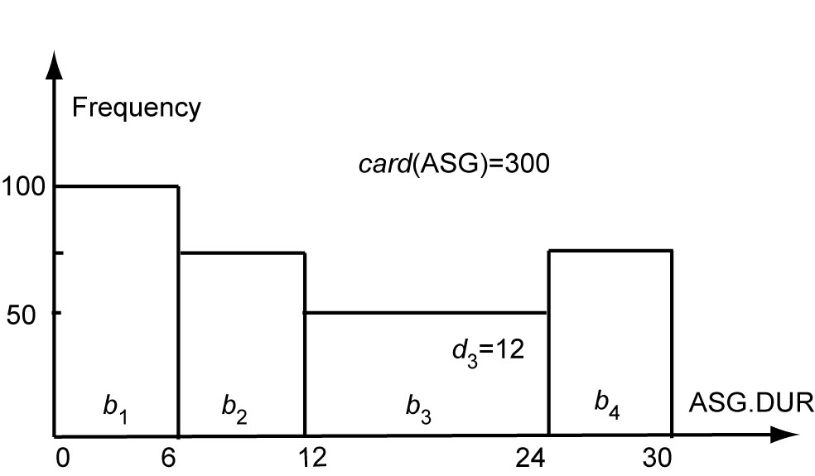
Histogram Example
For ASG.DUR=18: we have SF=1/12 so the card of selection is 300/12 = 25 tuples
For ASG.DUR≤18: we have min(range₃)=12 and max(range₃)=24 so the card. of selection is 100+75+(((18−12)/(24 − 12))*50) = 200 tuples

Slide 21
Centralized Query Optimization
Dynamic (Ingres project at UCB)
Interpretive
Static (System R project at IBM)
Exhaustive search
Hybrid (Volcano project at OGI)
Choose node within plan

Slide 22
Dynamic Algorithm
Decompose each multi-variable query into a sequence of mono-variable queries with a common variable
Process each by a one variable query processor
Choose an initial execution plan (heuristics)
Order the rest by considering intermediate relation sizes
No statistical information is maintained

Slide 23
Dynamic Algorithm–Decomposition
Replace an n variable query q by a series of queries
q₁→q₂ → … → q_{n}
where q_{i} uses the result of q_{i-1}.
Detachment
Query q decomposed into q' → q" where q' and q" have a common variable which is the result of q'
Tuple substitution
Replace the value of each tuple with actual values and simplify the query
q(V₁, V₂, ... V_{n}) → (q' (t₁, V₂, V₂, ... , V_{n}), t₁∈R)

Slide 24
Detachment
q: SELECT V₂.A₂,V₃.A₃, …,V_{n}.A_{n}
FROM R₁ V₁, …,R_{n} V_{n}
WHERE P₁(V₁.A₁’)AND P₂(V₁.A₁,V₂.A₂,…, V_{n}.A_{n})
⇓
q': SELECT V₁.A₁ INTO R₁'
FROM R₁ V₁
WHERE P₁(V₁.A₁)
q": SELECT V₂.A₂, …,V_{n}.A_{n}
FROM R₁' V₁, R₂ V₂, …,R_{n} V_{n}
WHERE P₂(V₁.A₁, V₂.A₂, …,V_{n}.A_{n})

Slide 25
Detachment Example
Names of employees working on CAD/CAM project
q₁: SELECT EMP.ENAME
FROM EMP, ASG, PROJ
WHERE EMP.ENO=ASG.ENO
AND ASG.PNO=PROJ.PNO
AND PROJ.PNAME="CAD/CAM"
⇓
q₁₁: SELECT PROJ.PNO INTO JVAR
FROM PROJ
WHERE PROJ.PNAME="CAD/CAM"
q': SELECT EMP.ENAME
FROM EMP,ASG,JVAR
WHERE EMP.ENO=ASG.ENO
AND ASG.PNO=JVAR.PNO

Slide 26
Detachment Example (cont’d)
q': SELECT EMP.ENAME
FROM EMP,ASG,JVAR
WHERE EMP.ENO=ASG.ENO
AND ASG.PNO=JVAR.PNO
⇓
q₁₂: SELECT ASG.ENO INTO GVAR
FROM ASG,JVAR
WHERE ASG.PNO=JVAR.PNO
q₁₃: SELECT EMP.ENAME
FROM EMP,GVAR
WHERE EMP.ENO=GVAR.ENO

Slide 27
Tuple Substitution
q₁₁ is a mono-variable query
q₁₂ and q₁₃ is subject to tuple substitution
Assume GVAR has two tuples only: 〈E1〉 and 〈E2〉
Then q₁₃ becomes
q₁₃₁: SELECT EMP.ENAME
FROM EMP
WHERE EMP.ENO="E1"
q₁₃₂: SELECT EMP.ENAME
FROM EMP
WHERE EMP.ENO="E2"

Slide 28
Static Algorithm
Simple (i.e., mono-relation) queries are executed according to the best access path
Execute joins
Determine the possible ordering of joins
Determine the cost of each ordering
Choose the join ordering with minimal cost

Slide 29
Static Algorithm
For joins, two alternative algorithms :
Nested loops
for each tuple of external relation (cardinality n₁)
for each tuple of internal relation (cardinality n₂)
join two tuples if the join predicate is true
end
end
Complexity: n₁* n₂
Merge join
sort relations
merge relations
Complexity: n₁+ n₂ if relations are previously sorted and equijoin

Slide 30
Static Algorithm – Example
Names of employees working on the CAD/CAM project
Assume
EMP has an index on ENO,
ASG has an index on PNO,
PROJ has an index on PNO and an index on PNAME
ASG
ENO
PNO
EMP
PROJ

Slide 31
Example (cont’d)
Choose the best access paths to each relation
EMP: sequential scan (no selection on EMP)
ASG: sequential scan (no selection on ASG)
PROJ: index on PNAME (there is a selection on PROJ based on PNAME)
Determine the best join ordering
EMP ▷◁ ASG ▷◁ PROJ
ASG ▷◁ PROJ ▷◁ EMP
PROJ ▷◁ ASG ▷◁ EMP
ASG ▷◁ EMP ▷◁ PROJ
EMP × PROJ ▷◁ ASG
PRO × JEMP ▷◁ ASG
Select the best ordering based on the join costs evaluated according to the two methods

Slide 32
Static Algorithm
Alternatives
EMP
ASG
PROJ
EMP ⋈ ASG
pruned
ASG ⋈ EMP
ASG ⋈ PROJ
pruned
PROJ ⋈ ASG
EMP × PROJ
pruned
PROJ × EMP
pruned
(ASG ⋈ EMP) ⋈ PROJ
(PROJ ⋈ ASG) ⋈ EMP
Best total join order is one of
((ASG ⋈ EMP) ⋈ PROJ)
((PROJ ⋈ ASG) ⋈ EMP)

Slide 33
Static Algorithm
((PROJ ⋈ ASG) ⋈ EMP) has a useful index on the select attribute and direct access to the join attributes of ASG and EMP
Therefore, chose it with the following access methods:
select PROJ using index on PNAME
then join with ASG using index on PNO
then join with EMP using index on ENO

Slide 34
Hybrid optimization
In general, static optimization is more efficient than dynamic optimization
Adopted by all commercial DBMS
But even with a sophisticated cost model (with histograms), accurate cost prediction is difficult
Example
Consider a parametric query with predicate
WHERE R.A = $a /* $a is a parameter
The only possible assumption at compile time is uniform distribution of values
Solution: Hybrid optimization
Choose-plan done at runtime, based on the actual parameter binding

Slide 35
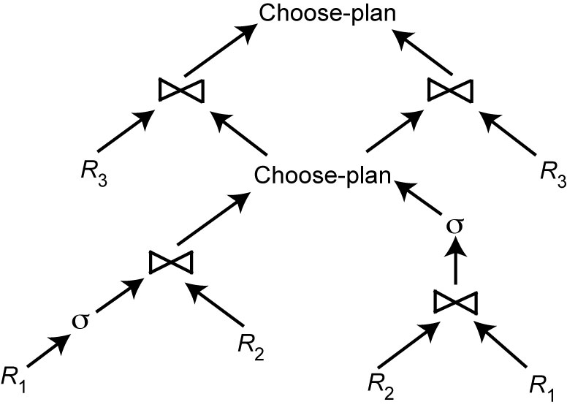
Hybrid Optimization Example
$a=A
$a=A

Slide 36
Join Ordering in Fragment Queries
Ordering joins
Distributed INGRES
System R*
Two-step
Semijoin ordering
SDD-1

Slide 37
Join Ordering
Consider two relations only
if size(R) < size(S)
R
S
if size(R) > size(S)
Multiple relations more difficult because too many alternatives.
Compute the cost of all alternatives and select the best one.
Necessary to compute the size of intermediate relations which is difficult.
Use heuristics

Slide 38
Join Ordering – Example
Consider
PROJ ⋈_{PNO} ASG ⋈_{ENO} EMP
Site 2
ASG
ENO
PNO
EMP
PROJ
Site 1
Site 3

Slide 39
Join Ordering – Example
Execution alternatives:
1. EMP→ Site 2 2. ASG → Site 1
Site 2 computes EMP'=EMP ⋈ ASG Site 1 computes EMP'=EMP ⋈ ASG
EMP'→ Site 3 EMP' → Site 3
Site 3 computes EMP' ⋈ PROJ Site 3 computes EMP’ ⋈ PROJ
3. ASG → Site 3 4. PROJ → Site 2
Site 3 computes ASG'=ASG ⋈ PROJ Site 2 computes PROJ'=PROJ ⋈ ASG
ASG' → Site 1 PROJ' → Site 1
Site 1 computes ASG' ▷◁ EMP Site 1 computes PROJ' ⋈ EMP
5. EMP → Site 2
PROJ → Site 2
Site 2 computes EMP ⋈ PROJ ⋈ ASG

Slide 40
Semijoin Algorithms
Consider the join of two relations:
R[A] (located at site 1)
S[A](located at site 2)
Alternatives:
Do the join R ⋈_{A}S
Perform one of the semijoin equivalents
R ⋈_{A}S ⇔ (R ⋉_{A}S) ⋈_{A}S
⇔ R ⋈_{A} (S ⋉_{A} R)
⇔ (R ⋉_{A} S) ⋈_{A} (S ⋉_{A} R)

Slide 41
Semijoin Algorithms
Perform the join
send R to Site 2
Site 2 computes R ⋈_{A} S
Consider semijoin (R ⋉_{A}S) ⋈_{A}S
S' = Π_{A}(S)
S' → Site 1
Site 1 computes R' = R ⋉_{A}S'
R'→ Site 2
Site 2 computes R' ⋈_{A}S
Semijoin is better if
size(Π_{A}(S)) + size(R ⋉_{A}S)) < size(R)

Slide 42
Distributed Dynamic Algorithm
Execute all monorelation queries (e.g., selection, projection)
Reduce the multirelation query to produce irreducible subqueries
q₁→ q₂ → … → q_{n}such that there is only one relation between q_{i} and q_{i+1}
Choose q_{i} involving the smallest fragments to execute (call MRQ')
Find the best execution strategy for MRQ'
Determine processing site
Determine fragments to move
Repeat 3 and 4

Slide 43
Static Approach
Cost function includes local processing as well as transmission
Considers only joins
“Exhaustive” search
Compilation
Published papers provide solutions to handling horizontal and vertical fragmentations but the implemented prototype does not

Slide 44
Static Approach – Performing Joins
Ship whole
Larger data transfer
Smaller number of messages
Better if relations are small
Fetch as needed
Number of messages = O(cardinality of external relation)
Data transfer per message is minimal
Better if relations are large and the selectivity is good

Slide 45
Static Approach – Vertical Partitioning & Joins
1. Move outer relation tuples to the site of the inner relation
(a) Retrieve outer tuples
(b) Send them to the inner relation site
(c) Join them as they arrive
Total Cost = cost(retrieving qualified outer tuples)
+ no. of outer tuples fetched * cost(retrieving qualified inner tuples)
+ msg. cost * (no. outer tuples fetched * avg. outer tuple size)/msg. size

Slide 46
Static Approach – Vertical Partitioning & Joins
2. Move inner relation to the site of outer relation
Cannot join as they arrive; they need to be stored
Total cost = cost(retrieving qualified outer tuples)
+ no. of outer tuples fetched * cost(retrieving matching inner tuples from temporary storage)
+ cost(retrieving qualified inner tuples)
+ cost(storing all qualified inner tuples in temporary storage)
+ msg. cost * no. of inner tuples fetched * avg. inner tuple size/msg. size

Slide 47
Static Approach – Vertical Partitioning & Joins
3. Move both inner and outer relations to another site
Total cost = cost(retrieving qualified outer tuples)
+ cost(retrieving qualified inner tuples)
+ cost(storing inner tuples in storage)
+ msg. cost ⋅ (no. of outer tuples fetched * avg. outer tuple size)/msg. size
+ msg. cost * (no. of inner tuples fetched * avg. inner tuple size)/msg. size
+ no. of outer tuples fetched * cost(retrieving inner tuples from temporary storage)

Slide 48
Static Approach – Vertical Partitioning & Joins
4.Fetch inner tuples as needed
(a) Retrieve qualified tuples at outer relation site
(b) Send request containing join column value(s) for outer tuples to inner relation site
(c) Retrieve matching inner tuples at inner relation site
(d) Send the matching inner tuples to outer relation site
(e) Join as they arrive
Total Cost = cost(retrieving qualified outer tuples)
+ msg. cost * (no. of outer tuples fetched)
+ no. of outer tuples fetched * no. of inner tuples fetched * avg. inner tuple size * msg. cost / msg. size)
+ no. of outer tuples fetched * cost(retrieving matching inner tuples for one outer value)

Slide 49
Dynamic vs. Static vs Semijoin
Semijoin
SDD1 selects only locally optimal schedules
Dynamic and static approaches have the same advantages and drawbacks as in centralized case
But the problems of accurate cost estimation at compile-time are more severe
More variations at runtime
Relations may be replicated, making site and copy selection important
Hybrid optimization
Choose-plan approach can be used
2-step approach simpler

Slide 50
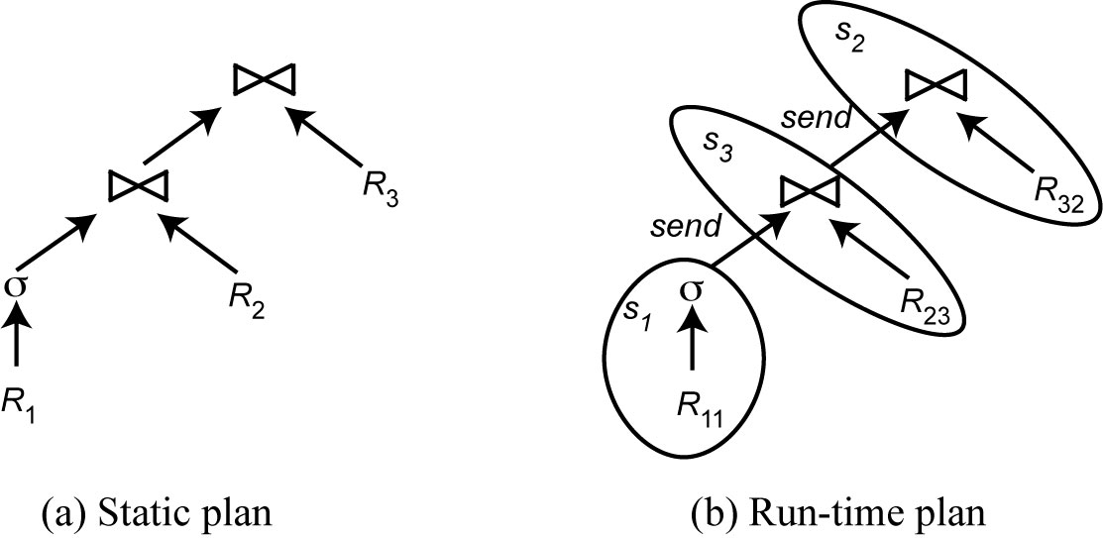
2-Step Optimization
At compile time, generate a static plan with operation ordering and access methods only
At startup time, carry out site and copy selection and allocate operations to sites

Slide 51
2-Step – Problem Definition
Given
A set of sites S = {s₁, s₂, …,s_{n}} with the load of each site
A query Q ={q₁, q₂, q₃, q₄} such that each subquery q_{i} is the maximum processing unit that accesses one relation and communicates with its neighboring queries
For each q_{i} in Q, a feasible allocation set of sites S_{q}={s₁, s₂, …,s_{k}} where each site stores a copy of the relation in q_{i}
The objective is to find an optimal allocation of Q to S such that
the load unbalance of S is minimized
The total communication cost is minimized

Slide 52
2-Step Algorithm
For each q in Q compute load (S_{q})
While Q not empty do
Select subquery a with least allocation flexibility
Select best site b for a (with least load and best benefit)
Remove a from Q and recompute loads if needed

Slide 53
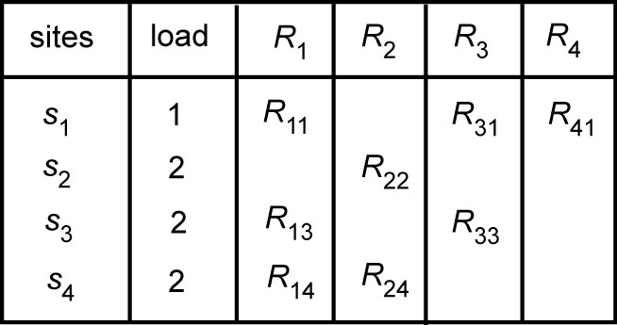
2-Step Algorithm Example
Let Q = {q₁, q₂, q₃, q₄} where q₁ is associated with R₁, q₂ is associated with R₂ joined with the result of q₁, etc.
Iteration 1: select q₄, allocate to s₁, set load(s₁)=2
Iteration 2: select q₂, allocate to s₂, set load(s₂)=3
Iteration 3: select q₃, allocate to s₁, set load(s₁) =3
Iteration 4: select q₁, allocate to s₃ or s₄
Note: if in iteration 2, q₂, were allocated to s₄, this would have produced
a better plan. So hybrid optimization can still miss optimal plans

